Slide 1
Design Team 4: Body
Nick Kamarianakis
Will Rose
Neal Traynor
Douglas Raymond
Jacob Hawley

Slide 2
Overview
Shape and size
Frame
Materials
Interior
Locking Mechanism

Slide 3
Shape and Size
Engineering Principles
Aerodynamics
Efficiency

Slide 4
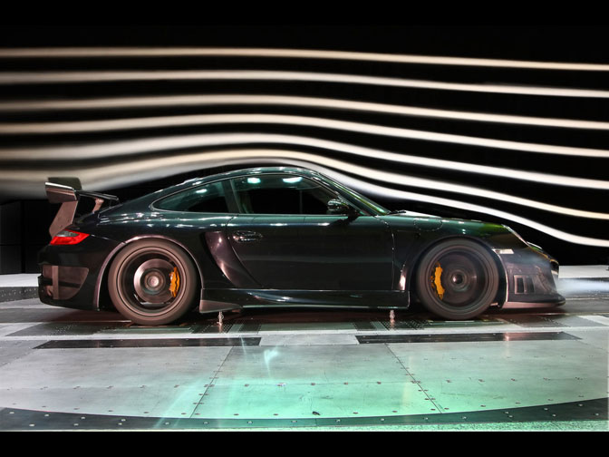


Slide 5
Frame
Engineering Principles
Force Distribution
Centre of mass

Slide 6
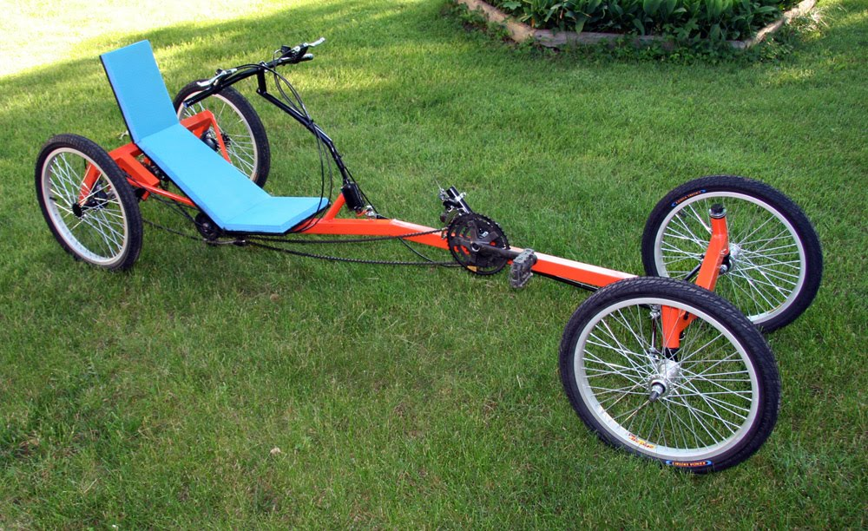
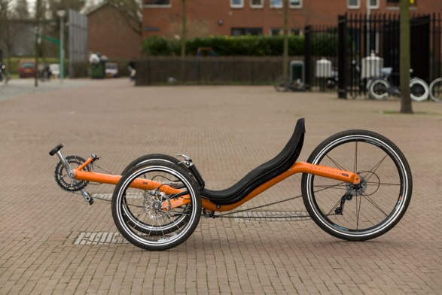

Slide 7
Materials
Engineering Principles:
Durability
Strength to Weight Ratio
Cost-Effective

Slide 8

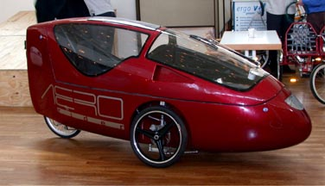

Slide 9
Interior Features
Engineering Principles
Ergonomics
Adaptability

Slide 10
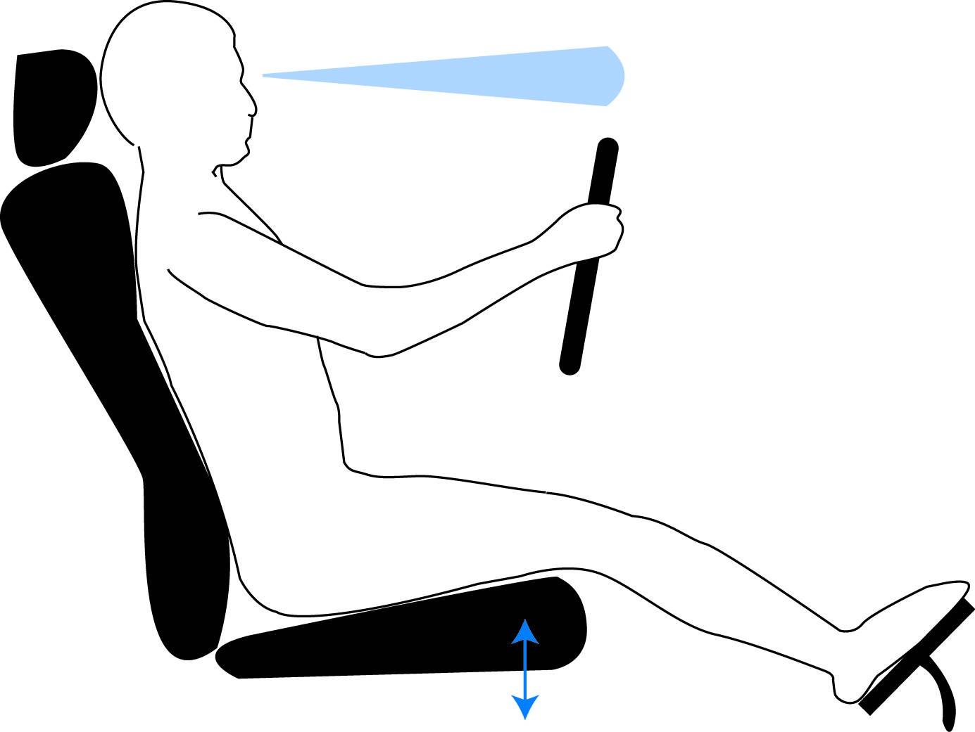
Ergonomics www.dreamsandmoney.com

Slide 11
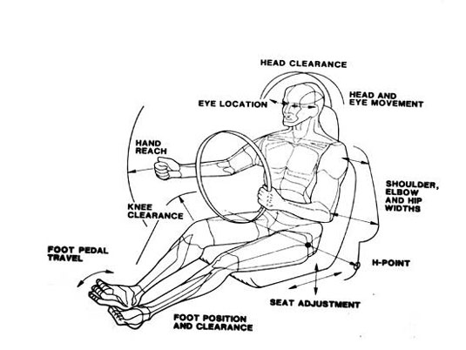
Adaptability www.dsource.in

Slide 12
Locking Mechanism
Engineering Principles
Durability
Simplicity
Effectiveness

Slide 13
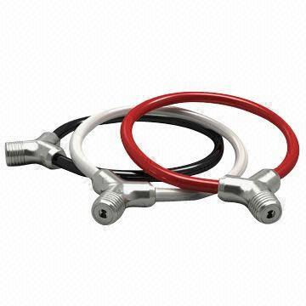

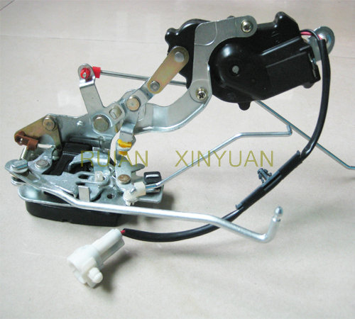

Slide 14
Thanks For Listening!
Questions?

